Slide 1
Decision Tree

Slide 2

Illustrating Classification Task
© Tan,Steinbach, Kumar Introduction to Data Mining 4/18/2004

Slide 3

Example of a Decision Tree
categorical
categorical
continuous
class
Splitting Attributes
Refund
Yes
No
NO
MarSt
Single, Divorced
Married
TaxInc
NO
< 80K
> 80K
NO
YES
Training Data
Model: Decision Tree
© Tan,Steinbach, Kumar Introduction to Data Mining 4/18/2004

Slide 4
Another Example of Decision Tree
categorical
categorical
continuous
class
MarSt
Single, Divorced
Married
NO
Refund
Yes
No
NO
TaxInc
< 80K
> 80K
NO
YES
There could be more than one tree that fits the same data!
© Tan,Steinbach, Kumar Introduction to Data Mining 4/18/2004

Slide 5

Decision Tree Classification Task
Decision Tree
© Tan,Steinbach, Kumar Introduction to Data Mining 4/18/2004

Slide 6

Apply Model to Test Data
Test Data
Start from the root of tree.
Refund
Yes
No
NO
MarSt
Single, Divorced
Married
TaxInc
NO
< 80K
> 80K
NO
YES
© Tan,Steinbach, Kumar Introduction to Data Mining 4/18/2004

Slide 7
Apply Model to Test Data
Test Data
Refund
Yes
No
NO
MarSt
Single, Divorced
Married
TaxInc
NO
< 80K
> 80K
NO
YES
© Tan,Steinbach, Kumar Introduction to Data Mining 4/18/2004

Slide 8

Apply Model to Test Data
Test Data
Refund
Yes
No
NO
MarSt
Single, Divorced
Married
TaxInc
NO
< 80K
> 80K
NO
YES
© Tan,Steinbach, Kumar Introduction to Data Mining 4/18/2004

Slide 9
Apply Model to Test Data
Test Data
Refund
Yes
No
NO
MarSt
Single, Divorced
Married
TaxInc
NO
< 80K
> 80K
NO
YES
© Tan,Steinbach, Kumar Introduction to Data Mining 4/18/2004

Slide 10

Apply Model to Test Data
Test Data
Refund
Yes
No
NO
MarSt
Single, Divorced
Married
TaxInc
NO
< 80K
> 80K
NO
YES
© Tan,Steinbach, Kumar Introduction to Data Mining 4/18/2004

Slide 11
Apply Model to Test Data
Test Data
Refund
Yes
No
NO
MarSt
Single, Divorced
Married
Assign Cheat to “No”
TaxInc
NO
< 80K
> 80K
NO
YES
© Tan,Steinbach, Kumar Introduction to Data Mining 4/18/2004

Slide 12

Decision Tree Classification Task
Decision Tree
© Tan,Steinbach, Kumar Introduction to Data Mining 4/18/2004

Slide 13
Decision Tree Induction
Many Algorithms:
  Hunt’s Algorithm (one of the earliest)
  CART
  ID3, C4.5
  SLIQ,SPRINT
© Tan,Steinbach, Kumar Introduction to Data Mining 4/18/2004

Slide 14

General Structure of Hunt’s Algorithm
Let D_{t} be the set of training records that reach a node t
General Procedure:
  If D_{t} contains records that belong the same class y_{t}, then t is a leaf node labeled as y_{t}
  If D_{t} is an empty set, then t is a leaf node labeled by the default class, y_{d}
  If D_{t} contains records that belong to more than one class, use an attribute test to split the data into smaller subsets. Recursively apply the procedure to each subset.
D_{t}
?
© Tan,Steinbach, Kumar Introduction to Data Mining 4/18/2004

Slide 15

Hunt’s Algorithm
Refund
Don’t
Cheat
Yes
No
Don’t
Cheat
Don’t
Cheat
Refund
Refund
Yes
No
Yes
No
Don’t
Cheat
Marital
Status
Don’t
Cheat
Marital
Status
Single,
Divorced
Single,
Divorced
Married
Married
Cheat
Don’t
Cheat
Taxable
Income
Don’t
Cheat
< 80K
>= 80K
Don’t
Cheat
Cheat
© Tan,Steinbach, Kumar Introduction to Data Mining 4/18/2004

Slide 16
Tree Induction
Greedy strategy.
  Split the records based on an attribute test that optimizes certain criterion.
Issues
  Determine how to split the records
    How to specify the attribute test condition?
    How to determine the best split?
  Determine when to stop splitting
© Tan,Steinbach, Kumar Introduction to Data Mining 4/18/2004

Slide 17
Tree Induction
Greedy strategy.
  Split the records based on an attribute test that optimizes certain criterion.
Issues
  Determine how to split the records
    How to specify the attribute test condition?
    How to determine the best split?
  Determine when to stop splitting
© Tan,Steinbach, Kumar Introduction to Data Mining 4/18/2004

Slide 18
How to Specify Test Condition?
Depends on attribute types
  Nominal
  Ordinal
  Continuous
Depends on number of ways to split
  2-way split
  Multi-way split
© Tan,Steinbach, Kumar Introduction to Data Mining 4/18/2004

Slide 19
Splitting Based on Nominal Attributes
Multi-way split: Use as many partitions as distinct values.
Binary split: Divides values into two subsets.
Need to find optimal partitioning.
CarType
Family
Luxury
Sports
CarType
CarType
{Sports, Luxury}
OR
{Family,
Luxury}
{Family}
{Sports}
© Tan,Steinbach, Kumar Introduction to Data Mining 4/18/2004

Slide 20
Splitting Based on Ordinal Attributes
Multi-way split: Use as many partitions as distinct values.
Binary split: Divides values into two subsets.
Need to find optimal partitioning.
What about this split?
Size
Small
Large
Medium
Size
Size
{Small, Medium}
OR
{Medium,
Large}
{Large}
{Small}
Size
{Small, Large}
{Medium}
© Tan,Steinbach, Kumar Introduction to Data Mining 4/18/2004

Slide 21
Splitting Based on Continuous Attributes
Different ways of handling
  Discretization to form an ordinal categorical attribute
    Static – discretize once at the beginning
    Dynamic – ranges can be found by equal interval bucketing, equal frequency bucketing
    (percentiles), or clustering.
  Binary Decision: (A < v) or (A ≥ v)
    consider all possible splits and finds the best cut
    can be more compute intensive
© Tan,Steinbach, Kumar Introduction to Data Mining 4/18/2004

Slide 22
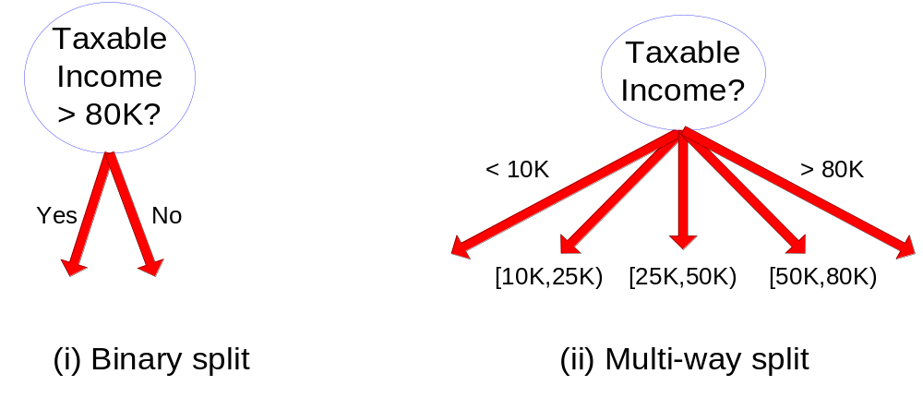
Splitting Based on Continuous Attributes
© Tan,Steinbach, Kumar Introduction to Data Mining 4/18/2004

Slide 23
Tree Induction
Greedy strategy.
  Split the records based on an attribute test that optimizes certain criterion.
Issues
  Determine how to split the records
    How to specify the attribute test condition?
    How to determine the best split?
  Determine when to stop splitting
© Tan,Steinbach, Kumar Introduction to Data Mining 4/18/2004

Slide 24

How to determine the Best Split
Before Splitting: 10 records of class 0,
10 records of class 1
Which test condition is the best?
© Tan,Steinbach, Kumar Introduction to Data Mining 4/18/2004

Slide 25


How to determine the Best Split
Greedy approach:
  Nodes with homogeneous class distribution are preferred
Need a measure of node impurity:
Non-homogeneous,
High degree of impurity
Homogeneous,
Low degree of impurity
© Tan,Steinbach, Kumar Introduction to Data Mining 4/18/2004

Slide 26
Measures of Node Impurity
Gini Index
Entropy
Misclassification error
© Tan,Steinbach, Kumar Introduction to Data Mining 4/18/2004

Slide 27





How to Find the Best Split
Before Splitting:
M0
A?
B?
Yes
No
Yes
No
Node N1
Node N2
Node N3
Node N4
M1
M2
M3
M4
M12
M34
Gain = M0 – M12 vs M0 – M34
© Tan,Steinbach, Kumar Introduction to Data Mining 4/18/2004

Slide 28





Measure of Impurity: GINI
Gini Index for a given node t :
    (NOTE: p( j | t) is the relative frequency of class j at node t).
  Maximum (1 - 1/n_{c}) when records are equally distributed among all classes, implying least interesting information
  Minimum (0.0) when all records belong to one class, implying most interesting information
© Tan,Steinbach, Kumar Introduction to Data Mining 4/18/2004

Slide 29



Examples for computing GINI
P(C1) = 0/6 = 0 P(C2) = 6/6 = 1
Gini = 1 – P(C1)² – P(C2)² = 1 – 0 – 1 = 0
P(C1) = 1/6 P(C2) = 5/6
Gini = 1 – (1/6)² – (5/6)² = 0.278
P(C1) = 2/6 P(C2) = 4/6
Gini = 1 – (2/6)² – (4/6)² = 0.444
© Tan,Steinbach, Kumar Introduction to Data Mining 4/18/2004

Slide 30

Splitting Based on GINI
Used in CART, SLIQ, SPRINT.
When a node p is split into k partitions (children), the quality of split is computed as,
where, n_{i} = number of records at child i,
n = number of records at node p.
© Tan,Steinbach, Kumar Introduction to Data Mining 4/18/2004

Slide 31

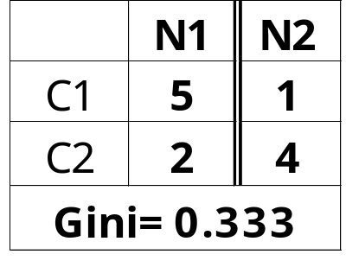
Binary Attributes: Computing GINI Index
Splits into two partitions
Effect of Weighing partitions:
  Larger and Purer Partitions are sought for.
B?
Yes
No
Node N1
Node N2
Gini(N1)
= 1 – (5/7)² – (2/7)²
= 0.408
Gini(N2)
= 1 – (1/5)² – (4/5)²
= 0.32
Gini(Children)
= 7/12 * 0.408 +
5/12 * 0.32
= 0.371
© Tan,Steinbach, Kumar Introduction to Data Mining 4/18/2004

Slide 32



Categorical Attributes: Computing Gini Index
For each distinct value, gather counts for each class in the dataset
Use the count matrix to make decisions
Multi-way split
Two-way split
(find best partition of values)
© Tan,Steinbach, Kumar Introduction to Data Mining 4/18/2004

Slide 33

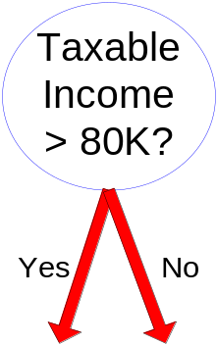
Continuous Attributes: Computing Gini Index
Use Binary Decisions based on one value
Several Choices for the splitting value
  Number of possible splitting values
  = Number of distinct values
Each splitting value has a count matrix associated with it
  Class counts in each of the partitions, A < v and A ≥ v
Simple method to choose best v
  For each v, scan the database to gather count matrix and compute its Gini index
  Computationally Inefficient! Repetition of work.
© Tan,Steinbach, Kumar Introduction to Data Mining 4/18/2004

Slide 34

Continuous Attributes: Computing Gini Index...
For efficient computation: for each attribute,
  Sort the attribute on values
  Linearly scan these values, each time updating the count matrix and computing gini index
  Choose the split position that has the least gini index
Sorted Values
Split Positions
© Tan,Steinbach, Kumar Introduction to Data Mining 4/18/2004

Slide 35

Alternative Splitting Criteria based on INFO
Entropy at a given node t:
    (NOTE: p( j | t) is the relative frequency of class j at node t).
  Measures homogeneity of a node.
    Maximum (log n_{c}) when records are equally distributed among all classes implying least information
    Minimum (0.0) when all records belong to one class, implying most information
  Entropy based computations are similar to the GINI index computations
© Tan,Steinbach, Kumar Introduction to Data Mining 4/18/2004

Slide 36

Examples for computing Entropy
P(C1) = 0/6 = 0 P(C2) = 6/6 = 1
Entropy = – 0 log 0 – 1 log 1 = – 0 – 0 = 0
P(C1) = 1/6 P(C2) = 5/6
Entropy = – (1/6) log₂ (1/6) – (5/6) log₂ (5/6) = 0.65
P(C1) = 2/6 P(C2) = 4/6
Entropy = – (2/6) log₂ (2/6) – (4/6) log₂ (4/6) = 0.92
© Tan,Steinbach, Kumar Introduction to Data Mining 4/18/2004

Slide 37

Splitting Based on INFO...
Information Gain:
    Parent Node, p is split into k partitions;
    n_{i} is number of records in partition i
  Measures Reduction in Entropy achieved because of the split. Choose the split that achieves most reduction (maximizes GAIN)
  Used in ID3 and C4.5
  Disadvantage: Tends to prefer splits that result in large number of partitions, each being small but pure.
© Tan,Steinbach, Kumar Introduction to Data Mining 4/18/2004

Slide 38

Splitting Criteria based on Classification Error
Classification error at a node t :
Measures misclassification error made by a node.
    Maximum (1 - 1/n_{c}) when records are equally distributed among all classes, implying least interesting information
    Minimum (0.0) when all records belong to one class, implying most interesting information
© Tan,Steinbach, Kumar Introduction to Data Mining 4/18/2004

Slide 39
Examples for Computing Error
P(C1) = 0/6 = 0 P(C2) = 6/6 = 1
Error = 1 – max (0, 1) = 1 – 1 = 0
P(C1) = 1/6 P(C2) = 5/6
Error = 1 – max (1/6, 5/6) = 1 – 5/6 = 1/6
P(C1) = 2/6 P(C2) = 4/6
Error = 1 – max (2/6, 4/6) = 1 – 4/6 = 1/3
© Tan,Steinbach, Kumar Introduction to Data Mining 4/18/2004

Slide 40

Comparison among Splitting Criteria
For a 2-class problem:
© Tan,Steinbach, Kumar Introduction to Data Mining 4/18/2004

Slide 41
Tree Induction
Greedy strategy.
  Split the records based on an attribute test that optimizes certain criterion.
Issues
  Determine how to split the records
    How to specify the attribute test condition?
    How to determine the best split?
  Determine when to stop splitting
© Tan,Steinbach, Kumar Introduction to Data Mining 4/18/2004

Slide 42
Stopping Criteria for Tree Induction
Stop expanding a node when all the records belong to the same class
Stop expanding a node when all the records have similar attribute values
Early termination (to be discussed later)
© Tan,Steinbach, Kumar Introduction to Data Mining 4/18/2004

Slide 43
Decision Tree Based Classification
Advantages:
  Inexpensive to construct
  Extremely fast at classifying unknown records
  Easy to interpret for small-sized trees
  Accuracy is comparable to other classification techniques for many simple data sets
© Tan,Steinbach, Kumar Introduction to Data Mining 4/18/2004

Slide 44
Example: C4.5
Simple depth-first construction.
Uses Information Gain
Sorts Continuous Attributes at each node.
Needs entire data to fit in memory.
Unsuitable for Large Datasets.
  Needs out-of-core sorting.
You can download the software from:
http://www.cse.unsw.edu.au/~quinlan/c4.5r8.tar.gz
© Tan,Steinbach, Kumar Introduction to Data Mining 4/18/2004

Slide 45
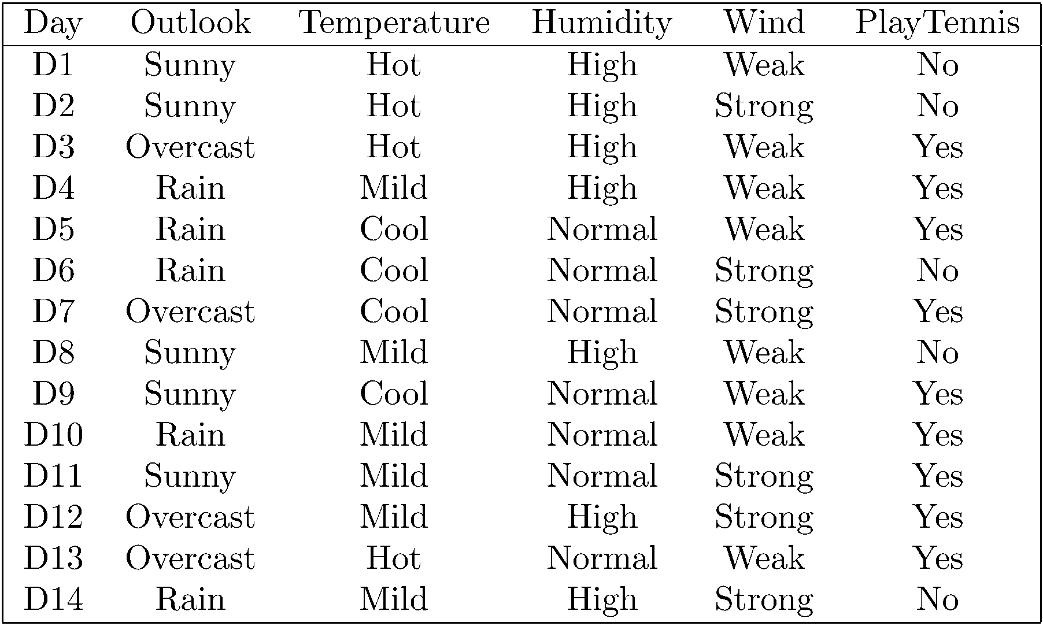
Training Examples

Slide 46
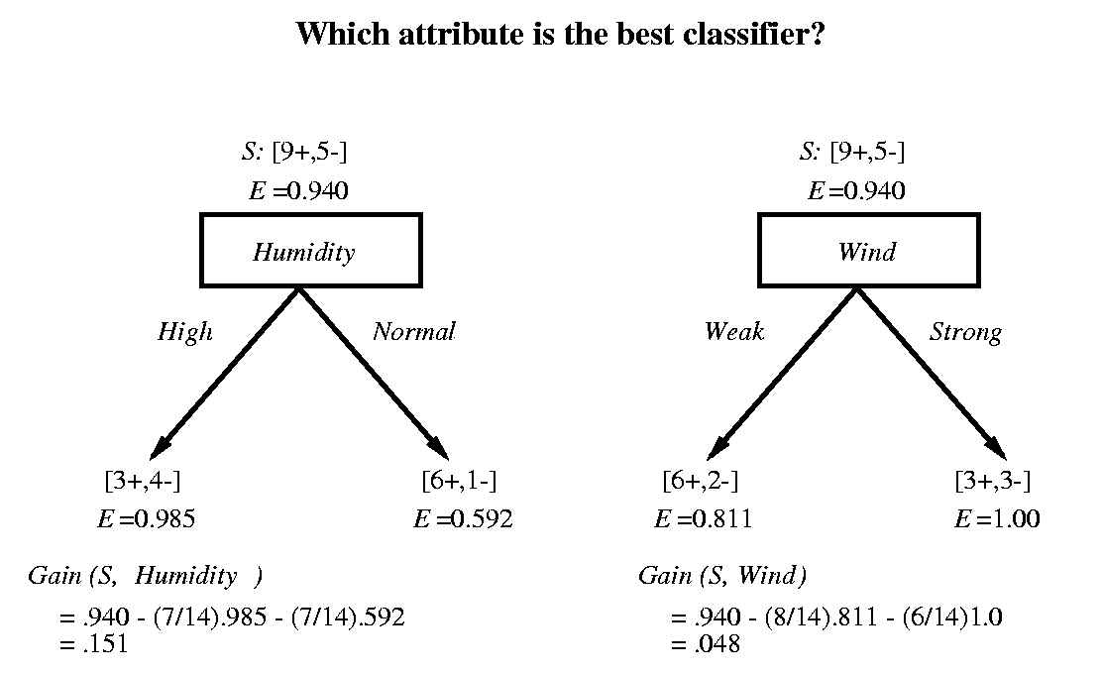
Selecting the Next Attribute

Slide 47
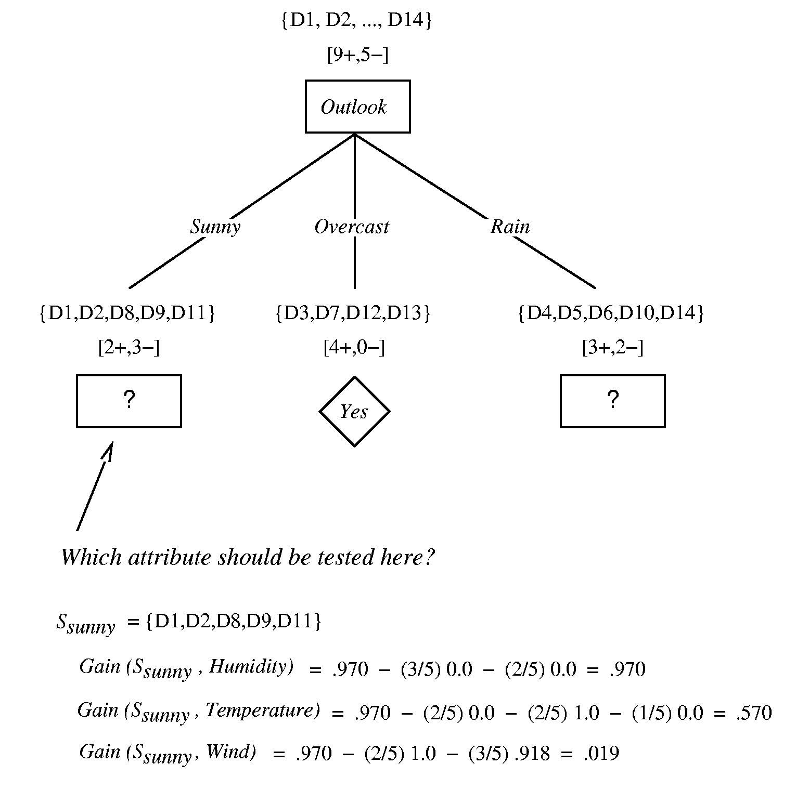



Selecting the Next Attribute
Gain(S, Outlook) =

Slide 48
Partially learned tree

Slide 49
Until stopped:
Select one of the unused attributes to partition the remaining examples at each non-terminal node
using only the training samples associated with that node
Stopping criteria:
each leaf-node contains examples of one type
algorithm ran out of attributes
…

Slide 50
Decision Tree for PlayTennis
Outlook
Sunny
Overcast
Rain
Humidity
Yes
Wind
High
Normal
Strong
Weak
No
Yes
No
Yes

Slide 51
Converting a Tree to Rules
Outlook
Sunny
Overcast
Rain
Humidity
Yes
Wind
High
Normal
Strong
Weak
No
Yes
No
Yes
R₁: If (Outlook=Sunny) ∧ (Humidity=High) Then PlayTennis=No
R₂: If (Outlook=Sunny) ∧ (Humidity=Normal) Then PlayTennis=Yes
R₃: If (Outlook=Overcast) Then PlayTennis=Yes
R₄: If (Outlook=Rain) ∧ (Wind=Strong) Then PlayTennis=No
R₅: If (Outlook=Rain) ∧ (Wind=Weak) Then PlayTennis=Yes

Slide 52
Decision Tree Code
https://machinelearningmastery.com/implement-decision-tree-algorithm-scratch-python/

